Slide 1
Forecasting Inventory Needs: Mathematics Textbooks
Anupriya Thirumurthy

Slide 2
Agenda
Business Case/Motivation
The Data
ARIMA Models
Linear Models
Limitations and Proposed Future Analysis

Slide 3
Business Case & Motivation
The Client: Chicago Distribution Center; a publishing company specializing in sourcing academic books to retailers.
The Problem: Sub-optimal inventory stocking.
The Solution: Define a model to accurately forecast required inventory/stock for all textbooks.
The ability to accurately forecast inventory reduces incidences of overstocking/understocking and allows for a reduction of costs of goods sold.

Slide 4
The Data: Exploratory Analysis, and Cleaning

Slide 5
Data: Description
Time series data for 79 unique ISBNs from July 2014 - April 2019.
Variables available include a unique ISBN identifier, date ordered, format, price, quantity ordered.
Variables selected: quantity ordered (dependent); price (independent).
Noticeable Issues:
Not necessarily clear that these are all unique titles.
Includes electronic books (license allocation vs. physical inventory).
Differing time intervals for each ISBN.
No singular price for each book.
Data is not aggregated.

Slide 6
Data Cleaning
Step 1: Drop E-books.
Reasoning: e-books are not relevant to physical inventory.
Step 2: Aggregate (FUN = sum) observations for each ISBN by Month/Year.
Reasoning: inventory stocking orders are made on a monthly basis.
Step 3: Use a weighted average aggregated price (per ISBN monthly).
Reasoning: acknowledges the existence of special discounts/price discrimination without skewing the aggregated price.
Step 4: Split into train/test.
Test data: 2018.

Slide 7
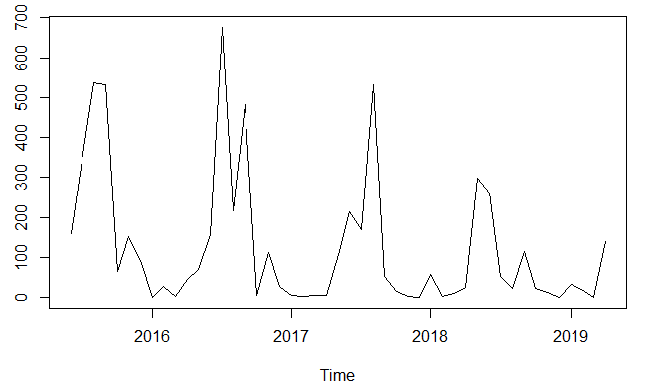
Demonstrative Series

Slide 8
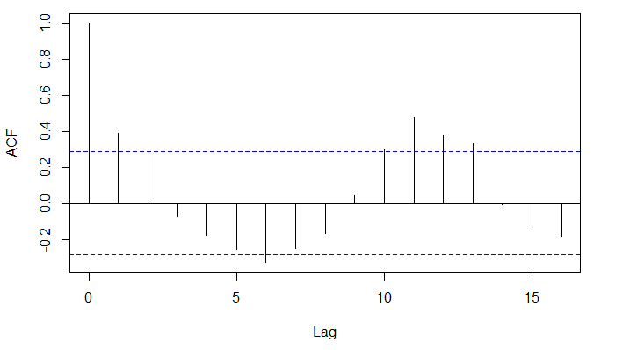
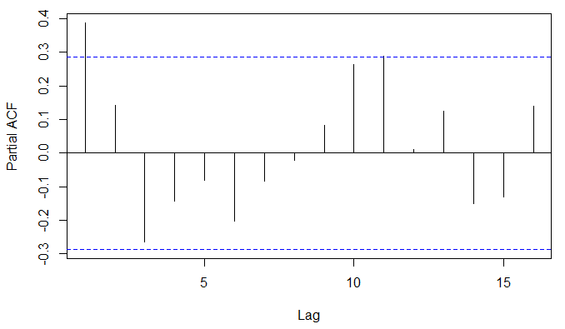
Testing for Stationarity
ADF Test P-Value: 0.01
KPSS Test P-Value: 0.1

Slide 9
ARIMA Models

Slide 10
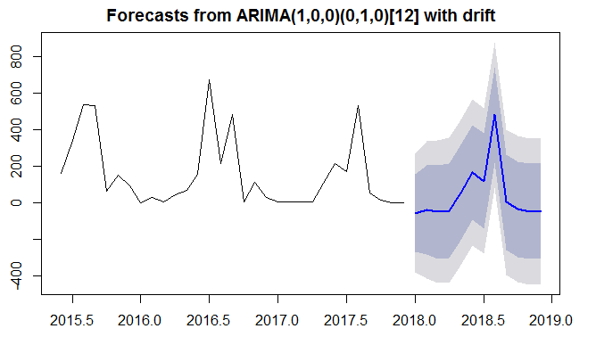
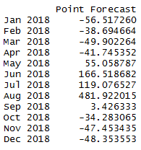
Round 1: Auto-Arima

Slide 11
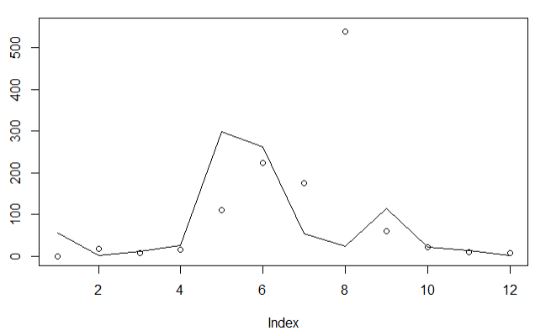
Adjustment of Forecasts

Slide 12
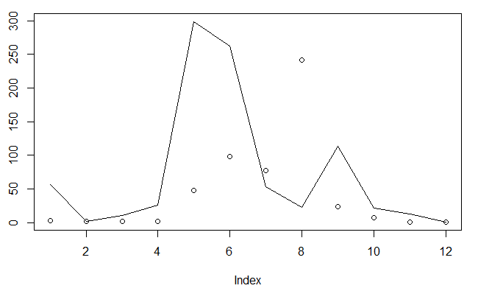
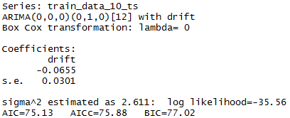
Round 2: Auto-Arima with Lambda = 0
SSE = 150309.5
MSE = 12525.8

Slide 13
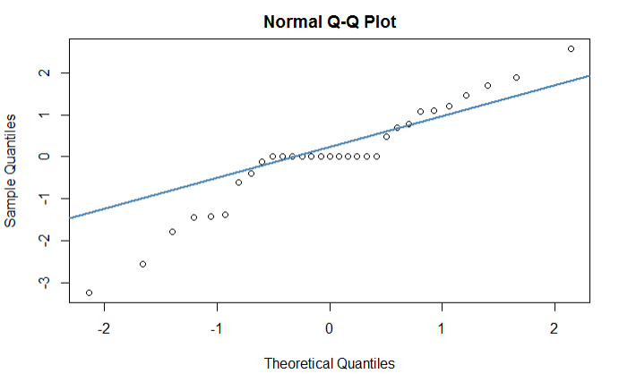
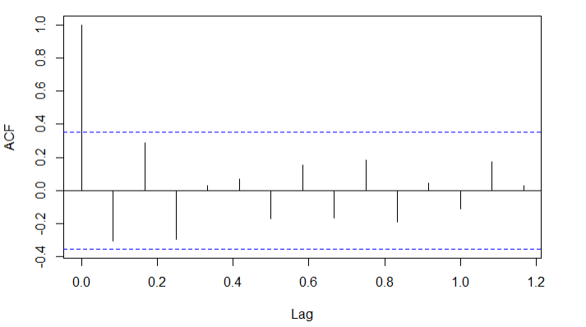
Model Validation: Analysis of Residuals
Box-Ljung Test p-value = 0.07

Slide 14
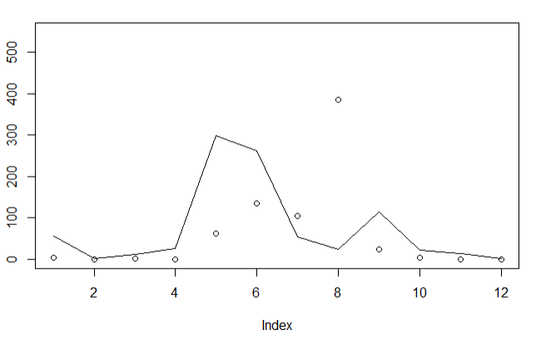
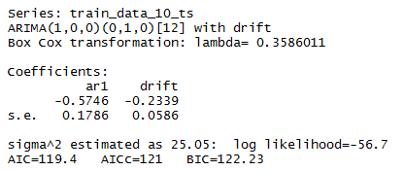
Round 3: Auto-Arima with Lambda = 0.359
SSE = 219062.7
MSE = 18255.2

Slide 15
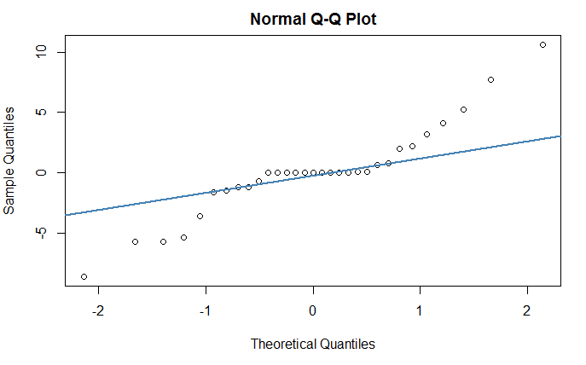
Model Validation: Analysis of Residuals
Box-Ljung Test p-value = 0.06

Slide 16
Linear Models (with and without ARIMA errors)
Notes:
Was there a reason to include external regressors

Slide 17
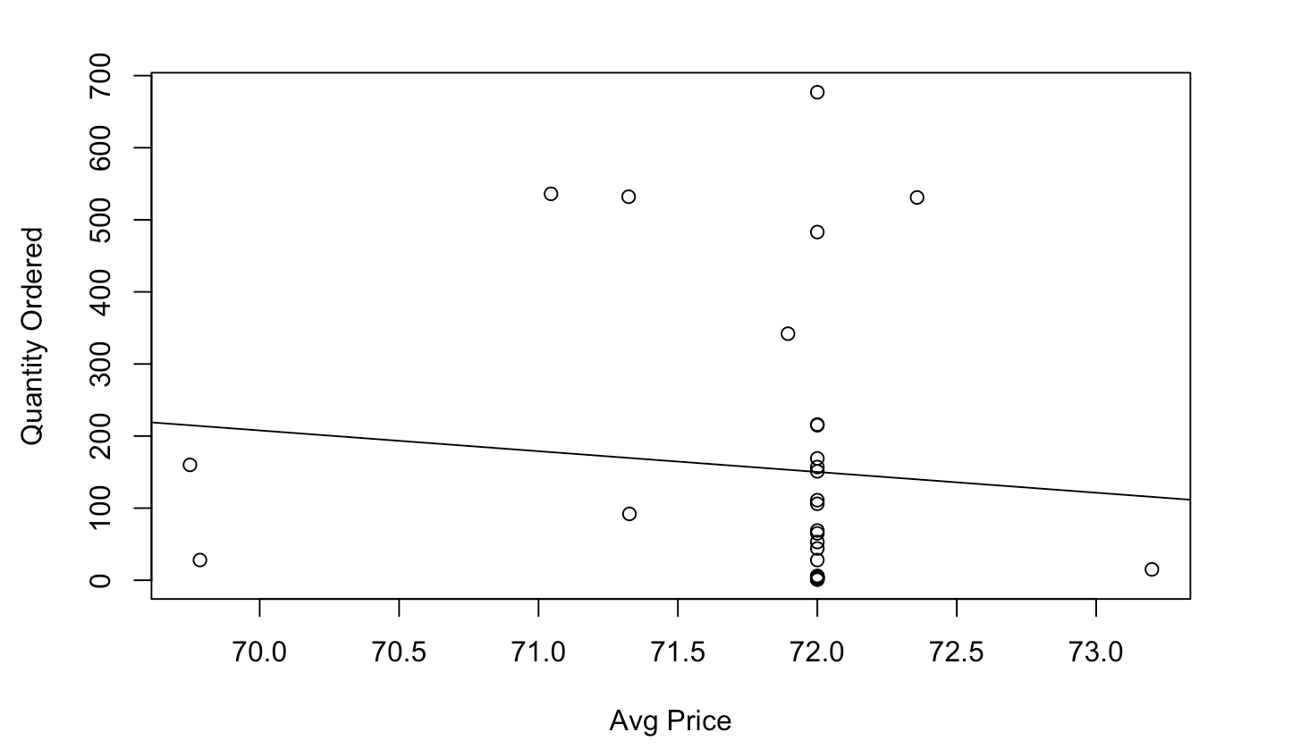
Average Price vs. Quantity Ordered

Slide 18
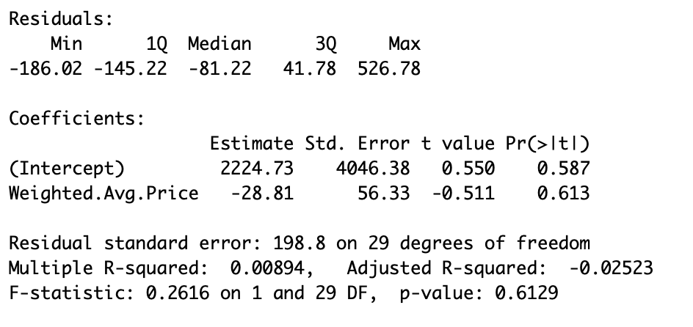

Slide 19
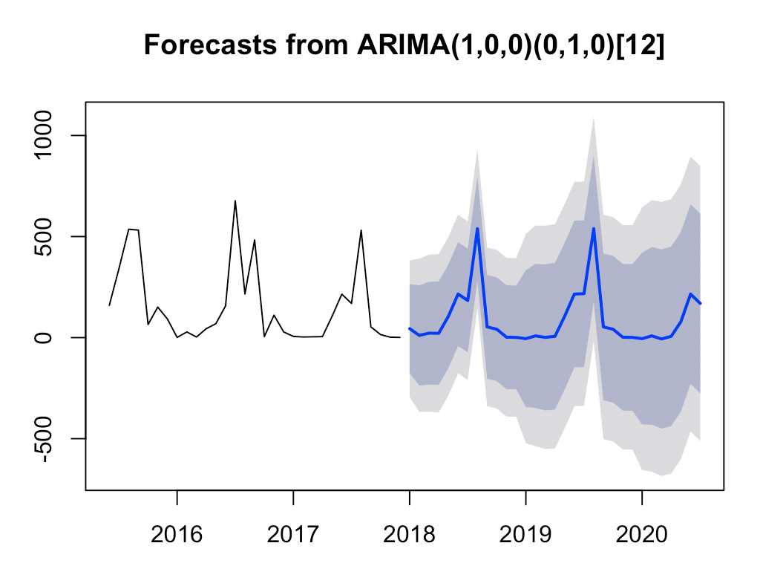
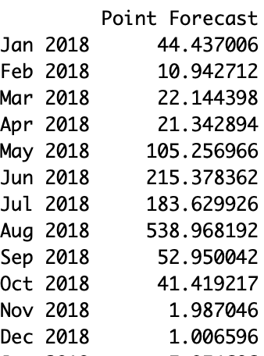
Linear Model with ARIMA errors

Slide 20
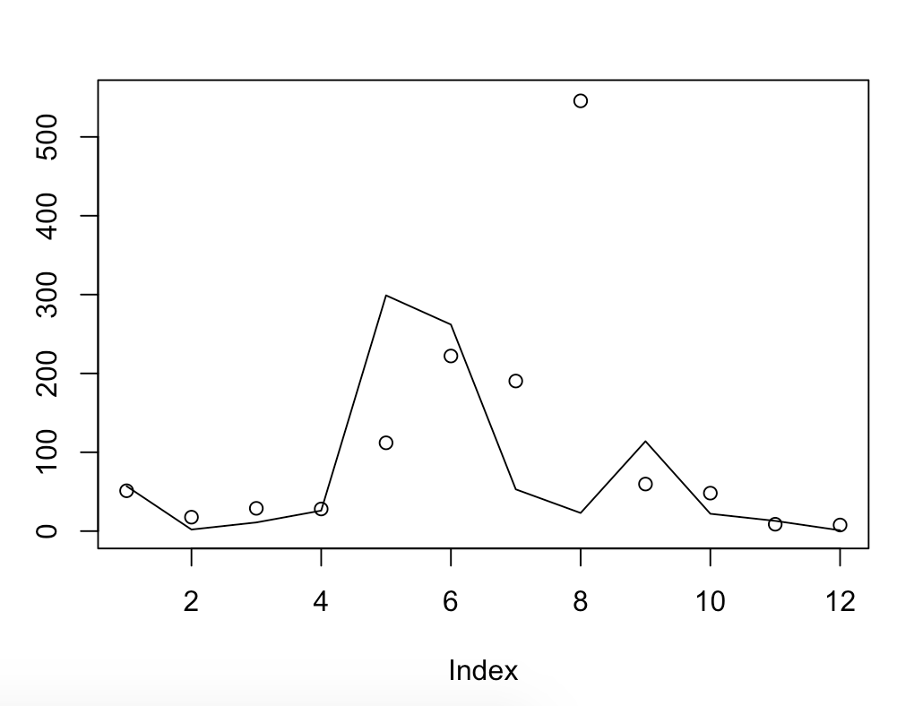
Forecasts vs. Actuals
SSE =347017
MSE = 28918.08

Slide 21
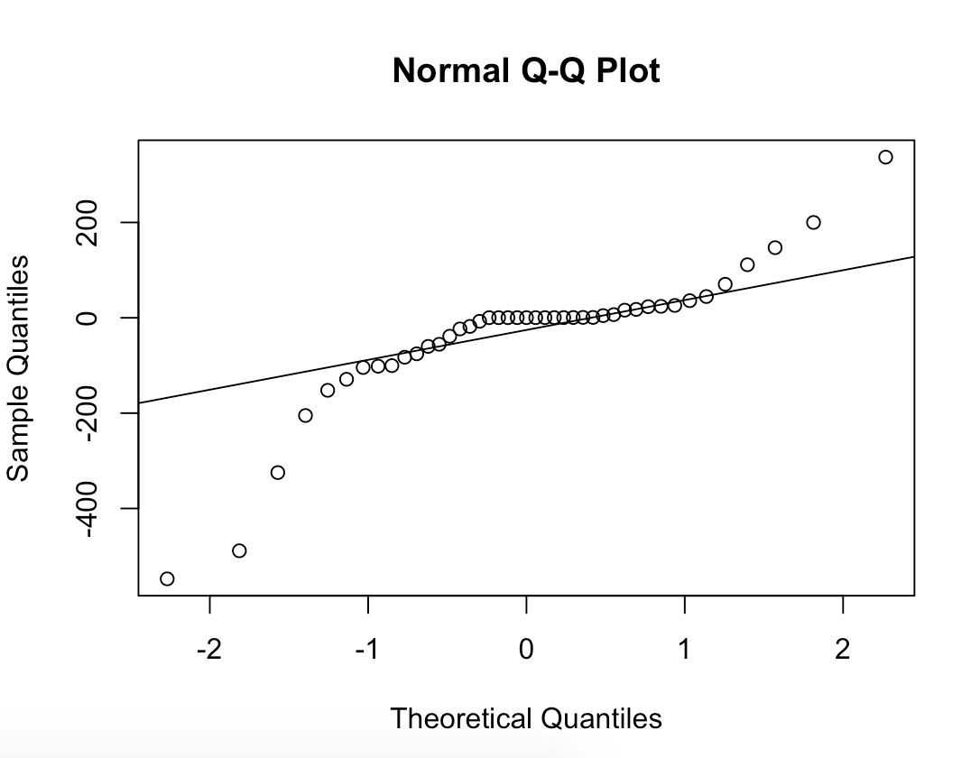
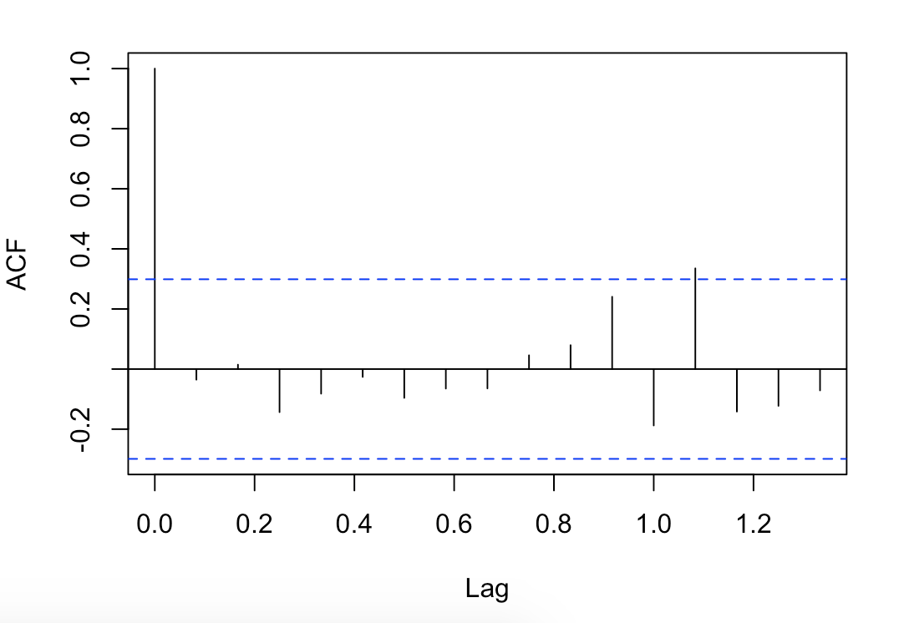
Model Validation: Analysis of Residuals
Box-Ljung Test p-value = 0.72

Slide 22
Selected Model: ARIMA Model with Log Transformation

Slide 23
What about other titles?

Slide 24
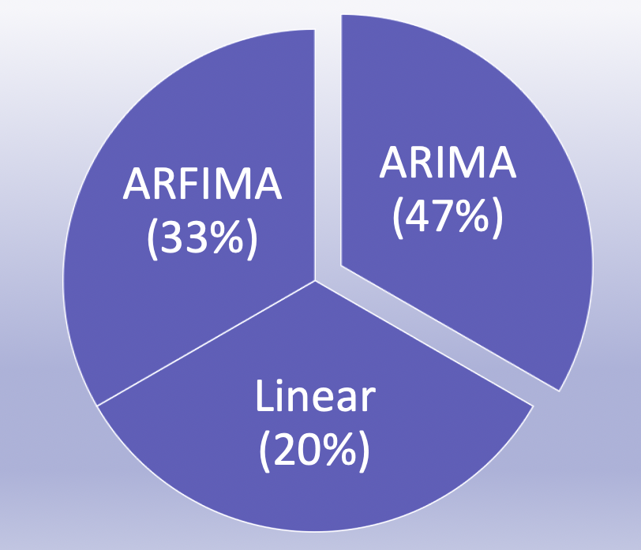
“Best” Model based on sMAPE
% of Model Wins across titles
ISBN | Linear Model | ARIMA | ARFIMA | Selected Model
1 | 36% | 20% | 49% | ARIMA
2 | 22% | 17% | 40% | ARIMA
3 | 18% | 17% | 10% | ARIMA
4 | 9% | 2% | 12% | ARIMA
6 | 19% | 10% | 7% | ARFIMA
8 | 30% | 13% | 0% | ARFIMA
14 | 3% | 3% | 28% | Linear/ARIMA
15 | 4% | 3% | 18% | ARIMA

Slide 25
Limitations and Future Work
Limitations:
Inaccurate forecasting
Unable to account for potential duplicates
Variation in model selection by title (computationally intensive)
Future Work:
Hierarchical forecasting
Incorporate returns into the analysis
Include other independent variables

